Slide 1
Data Warehouse
Akshay Appani

Slide 2
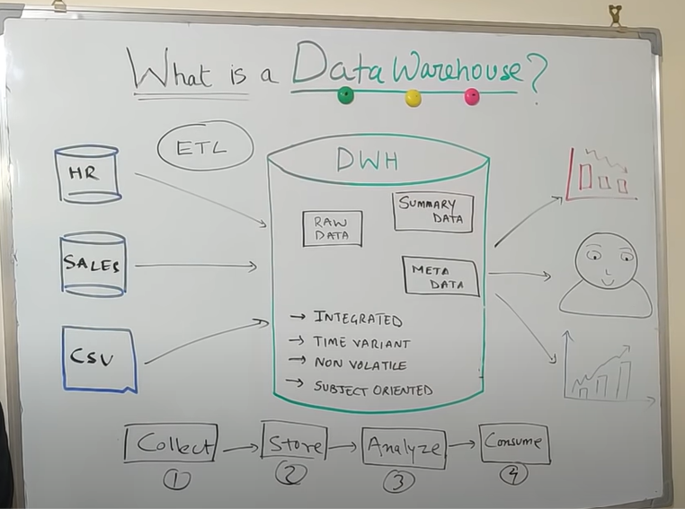
Data Warehouse
A data warehouse is like a storage where we store goods (storeroom small or big, Amazon warehouse where we store goods to be delivered) which are often not used generally store it a side like wise data
All the files and data are stored in a centralized system for analysis Ex: flat files, CSV,Excel etc.
All these data is stored in a central warehouse called data warehouse.
(only structured data can be stored like in a table format
Has attributes.)

Slide 3
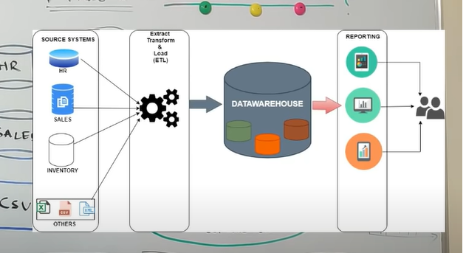
Whole data warehouse is divided in to 4 different stsges.
Collect
Store
Analyze
Consume
In first stage you fetch data from source system in its raw form in a staging layer in a process called ETL(Extract Transformation Load) of data Process. There are various tools to enable ETL for a data warehouse.

Slide 4

Basic Characteristics of a data warehouse.
Integrated: Data warehouse enables to integrate the data coming from various sources in a common format for further analysis.
Time Variant: What ever data stored in data warehouse varies with time that means we can do analysis by time.
Non-Volatile (static) : it means what ever data that comes to data warehouse remains static(it does not change, Changing data in data warehouse is not Possible).
Subject Oriented : A Data Warehouse is built for specific purposes it will resource on only those purposes that u built.

Slide 5
Difference Between a Data Base and Data Warehouse
Database:
A database is gathering of data at different places where new data comes and adds or deleting data is commonly taken place Such as transactional database, Sales database, all such databases come together in a Excel form, CSV form, Word/text form, Images data, Voice data etc. All these data bases are made for Faster Writes because our main objective is to store transaction in a quick way. Its an OLTP database.
Online Transactional Database(OLTP).
Data Warehouse:
A Data stored or Pushed in to a data warehouse with all details set no further changes needed is stored in a Data warehouse. The Objective of a Data warehouse is to faster reads because in data warehouse data is in millions or more with all data accumulation where you can only analyze and read data. It has various dimensions like Country, region, geography, customer, company etc. Its an OLAP database.
Online Analytical Processing Database(OLAP).
The OLTP data base is different from OLAP data Base

